Slide 1
Dynamic Simulations using the Ecosim platform
Sean Lucey
Northeast Fisheries Science Center
February 26, 2016

Slide 2
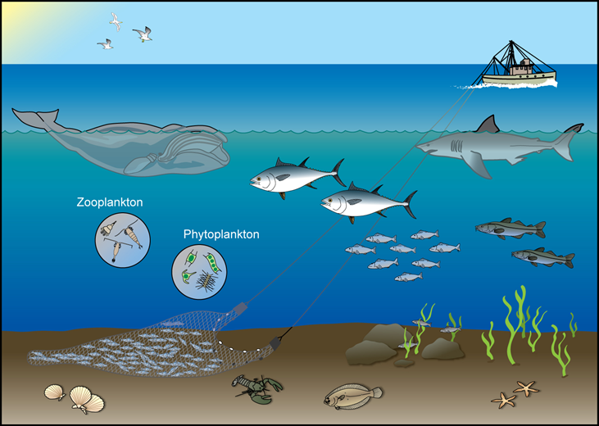
Role of Ecosystem models
Provide context and understanding
Mostly strategic advice
Limited tactical advice
Complement not replace single-species models
Notes:
Impact of target species, effects of top predators, competition between fisheries and predators
Impacts of biodiversity, non-retained bycatch, physical/environmental factors

Slide 3
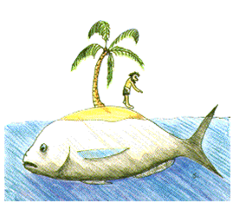
Ecopath with Ecosim
Ecopath - Food web modeling framework developed by Polovina (1984) and refined by Christensen and Pauly (1992)
Ecosim – Dynamic simulation developed by Walters et al. (1997)
Ecospace – Spatial dynamic simulations developed by Walters et al. (1999)

Slide 4
Best use
Identify and quantify major energy flows in the ecosystem
Describe ecosystem resources and their interactions
Evaluate the ecosystem effects of fishing or environmental changes
Explore management policy option
Plaganyi 2007

Slide 5
Ecosim
Uses mass-balance (Ecopath) for initial state
Time dynamic simulation
Utilizes ‘Foraging Arena Theory’
Includes both biomass and size-structure dynamics
Variable speed splitting
‘Fast’ equilibrium (phytoplankton/zooplankton)

Slide 6
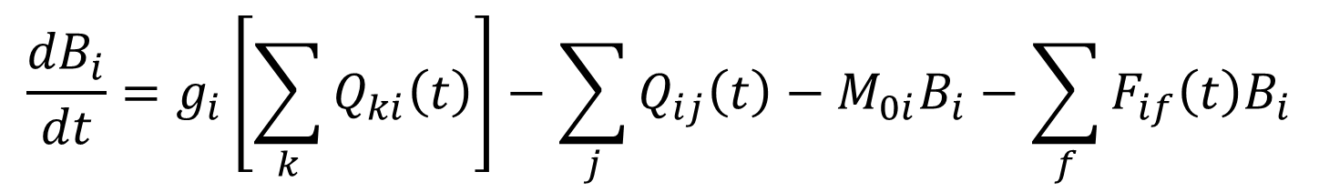
Biomass dynamics
Series of coupled differential equations
Based on Ecopath’s master equation for production
$$\frac{{dB}_{i}}{dt}=g_{i}\left[\sum_{k}{Q_{ki}\left(t\right)}\right]−\sum_{j}{Q_{ij}\left(t\right)}−M_{0i}B_{i}−\sum_{f}{F_{if}\left(t\right)B_{i}}$$

Slide 7
Predicting consumption
Classical food web models assumed “mass action” principles
Works for few, weak trophic interactions
When applied to whole ecosystems
Strong “top-down” control
Predictions of dynamic instability
Unstable community structure – loss of biodiversity

Slide 8
Foraging Arenas
p
p
Pr
z
P2
z
p
z
z
p
Pr
p
p
p
p
z
Pr
z
p
z
Pr
p
p

Slide 9
What it explains
Empty stomachs
High search efficiencies
Widespread complex trophic ontogeny
Lack of proportional dependence of M on predator abundance
Conservation of Z
“Bottom up” control patterns
High sensitivity of top predators to fishing
Higher biodiversity
Walters and Martell 2004

Slide 10
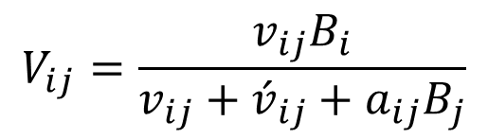
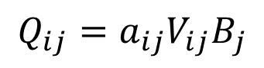
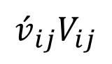
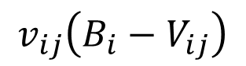
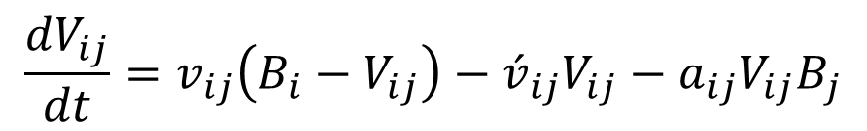
Predicting trophic flow
$$\frac{{dV}_{ij}}{dt}=v_{ij}\left(B_{i}−V_{ij}\right)−{\acute{v}}_{ij}V_{ij}−a_{ij}V_{ij}B_{j}$$
Predator
B_{j}
$$V_{ij}=\frac{v_{ij}B_{i}}{v_{ij}+{\acute{v}}_{ij}+a_{ij}B_{j}}$$
$$Q_{ij}=a_{ij}V_{ij}B_{j}$$
$$v_{ij}\left(B_{i}−V_{ij}\right)$$
Unavailable Prey
B_{i} - V_{ij}
Available Prey
V_{ij}
$${\acute{v}}_{ij}V_{ij}$$

Slide 11
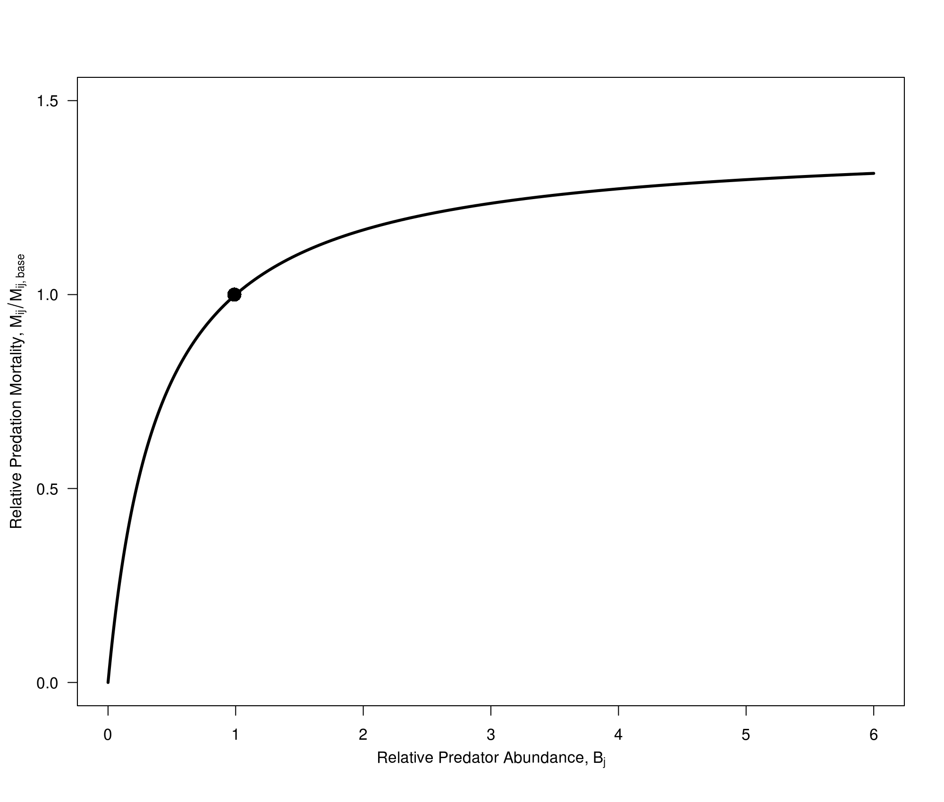
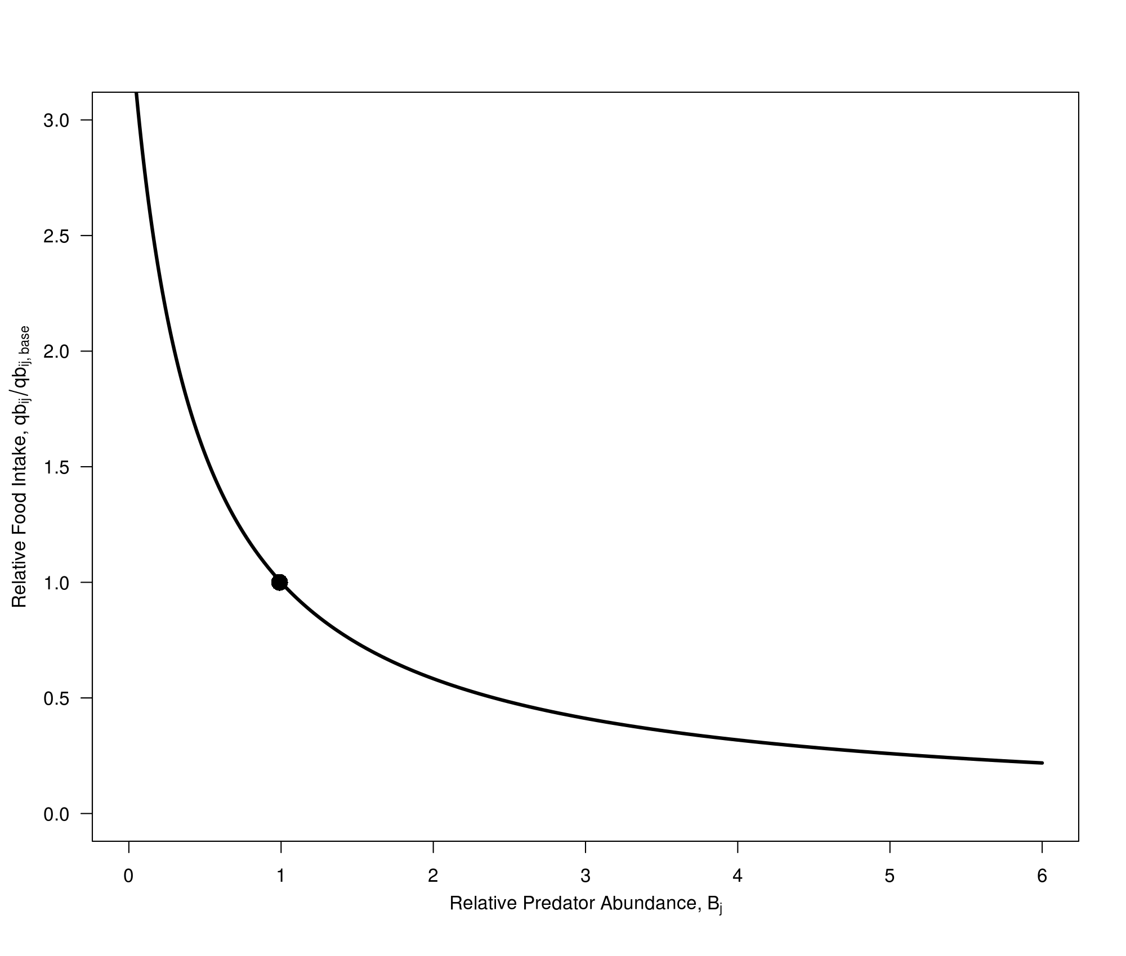
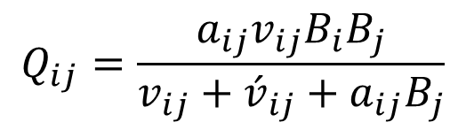
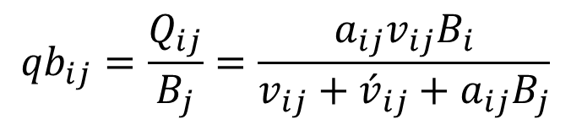
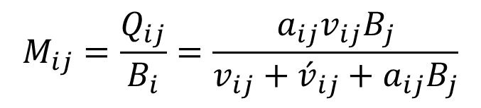
Foraging Arena relationships
$$Q_{ij}=\frac{a_{ij}v_{ij}B_{i}B_{j}}{v_{ij}+{\acute{v}}_{ij}+a_{ij}B_{j}}$$
$$M_{ij}=\frac{Q_{ij}}{B_{i}}=\frac{a_{ij}v_{ij}B_{j}}{v_{ij}+{\acute{v}}_{ij}+a_{ij}B_{j}}$$
$${qb}_{ij}=\frac{Q_{ij}}{B_{j}}=\frac{a_{ij}v_{ij}B_{i}}{v_{ij}+{\acute{v}}_{ij}+a_{ij}B_{j}}$$
Notes:
Can not empirically estimate vij or aij
Simplicity represents a wide range of behavior and physical processes
Does not account for Mij possibly being dependent on Bi and Type III functional responses.

Slide 12

Adding realism
Handling time
Foraging time adjustment
Mediation
classicjacksonarts.com

Slide 13

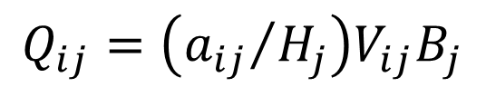
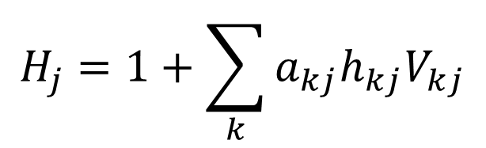
Handling Time
Constraint on consumption
Pursuit
Capture
Manipulation
Dynamic state variable
QB_{max}:QB*
$$Q_{ij}=\left({a_{ij}}/{H_{j}}\right)V_{ij}B_{j}$$
$$H_{j}=1+\sum_{k}{a_{kj}h_{kj}V_{kj}}$$

Slide 14

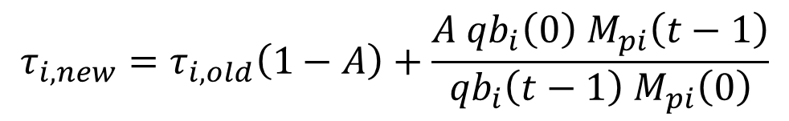
Foraging Time Adjustment
Ability to increase/decrease time spent foraging to maintain a stable consumption rate
Increase/decrease exposure to predation
$$τ_{i, new}=τ_{i, old}\left(1−A\right)+\frac{A{ qb}_{i}\left(0\right){ M}_{pi}\left(t−1\right)}{{qb}_{i}\left(t−1\right){ M}_{pi}\left(0\right)}$$

Slide 15
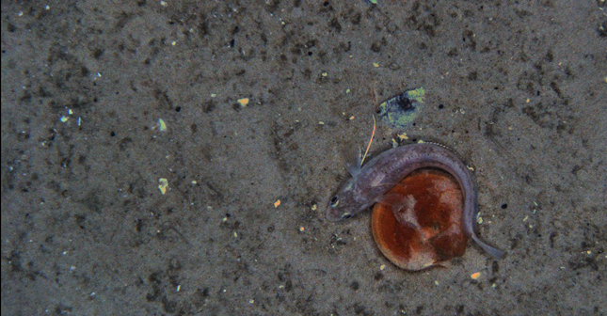
Trophic mediation
Indirect effects of one group on another
Protection for juveniles
Impact on search rates
Unique foraging arenas

Slide 16
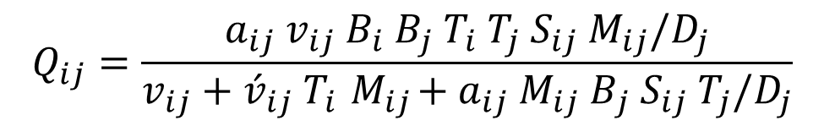
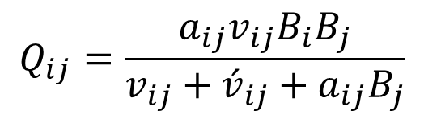
Realistic consumption
Original consumption
“Realistic” consumption
Where T is foraging time, S is a seasonal mediation, M is trophic mediation, and D is handling time
$$Q_{ij}=\frac{a_{ij}v_{ij}B_{i}B_{j}}{v_{ij}+{\acute{v}}_{ij}+a_{ij}B_{j}}$$
$$Q_{ij}=\frac{a_{ij}{ v}_{ij}{ B}_{i}{ B}_{j}{ T}_{i}{ T}_{j}{ S}_{ij}{ M}_{ij}/D_{j}}{v_{ij}+{\acute{v}}_{ij} T_{i}{ M}_{ij}+a_{ij} {M_{ij} B}_{j} S_{ij} T_{j}/D_{j}}$$

Slide 17
Parameters
Vulnerability
Max relative feeding time
Feeding time adjustment rate
QB_{max}:QB* (handling time)
Any mediating forcing functions

Slide 18
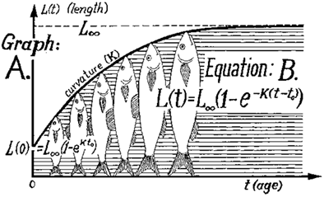
Size structure
Represent ontogenetic shifts
Deriso-Schnute delay-difference model
Tracks numbers and biomass
Can create as many stanzas as necessary
Notes:
Assume similar mortalities/DC per stanza
Assume von Bert growth (weight prop. to length)
Assume stable age structure

Slide 19

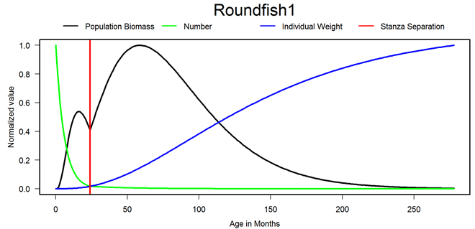

Slide 20
Parameters
Length of stanzas (months)
Z per stanza
Von Bertalanffy K
Relative weight at maturity (W_{mat}/W_{inf})
Only need B and QB for leading stanza

Slide 21
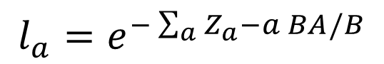
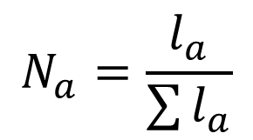
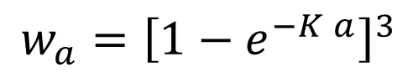
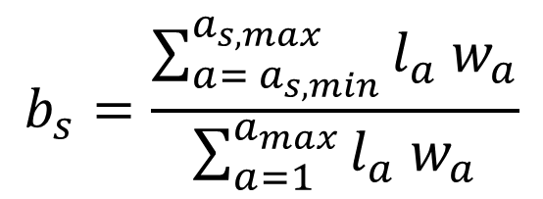
Keeping track
Relative numbers
where l_{a} is population growth rate-corrected survivorship
Relative biomass
$$N_{a}=\frac{l_{a}}{\sum{l_{a}}}$$
$$l_{a}=e^{−\sum_{a}{Z_{a}−a BA/B}}$$
$$b_{s}=\frac{\sum_{a= a_{s, min}}^{a_{s, max}}{l_{a}{ w}_{a}}}{\sum_{a=1}^{a_{max}}{l_{a} w_{a}}}$$
$$w_{a}={\left[1−e^{−K a}\right]}^{3}$$

Slide 22
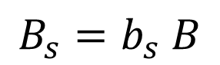
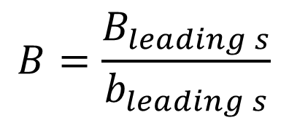
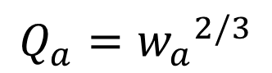
Use relative to get actual
Calculated total biomass using ‘leading’ stanza
Use total biomass to calculate stanza biomass
Similar process for consumption
$$B=\frac{B_{leading s}}{b_{leading s}}$$
$$B_{s}=b_{s} B$$
$$Q_{a}={w_{a}}^{2/3}$$

Slide 23
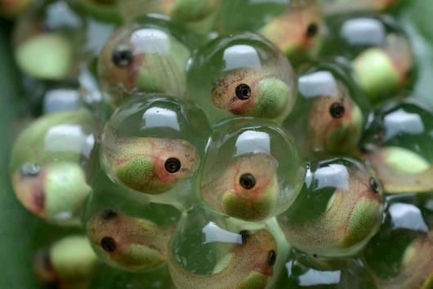
Recruitment
Fecundity assumed proportional to body weight
Size-numbers-dependent monthly egg production used to predict changes in recruitment to age 0
jimdaleywrites.com

Slide 24
Solving the processes
Differential equations solved through numerical integration
4th order Runge-Kutta
Adams-Bashforth
Requires short time steps (1 month)
Split out groups likely to remain at equilibrium

Slide 25

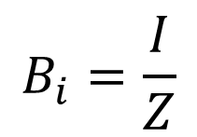
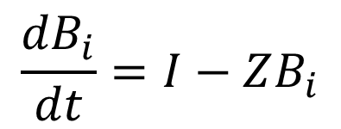
Speed-splitting
Groups with turnover faster than the time step are likely to stay at relative equilibrium
$$\frac{{dB}_{i}}{dt}=I−ZB_{i}$$
$$B_{i}=\frac{I}{Z}$$
russmarrs2-rise-of-sqeegee.wikia.com

Slide 26
Remember
Difficult to fully represent natural dynamics
Should be able to reproduce correct direction/order of magnitude perturbations
Values of the predicted outcomes are relative to each other especially those that impact policy choice

Slide 27
EwE time series fitting
EwE software has built-in fitting routines
Often necessary to include fisheries and environmental drivers to fit models
Unfortunately, Rpath is not set up to fit data yet

Slide 28
Lab
Review Anchovy Bay Ecopath model
Create an Ecosim scenario
Test simple strategies

Slide 29
